Slide 1


ARYAN LOHAN
Aug 31 2022

Slide 2













Slide 3



Checking the shape of Datasets
Checking the columns
Checking the Data types Of independent features
Checking the null values
Checking and dropping the unwanted columns
Checking Categorical columns and numerical columns

Slide 4
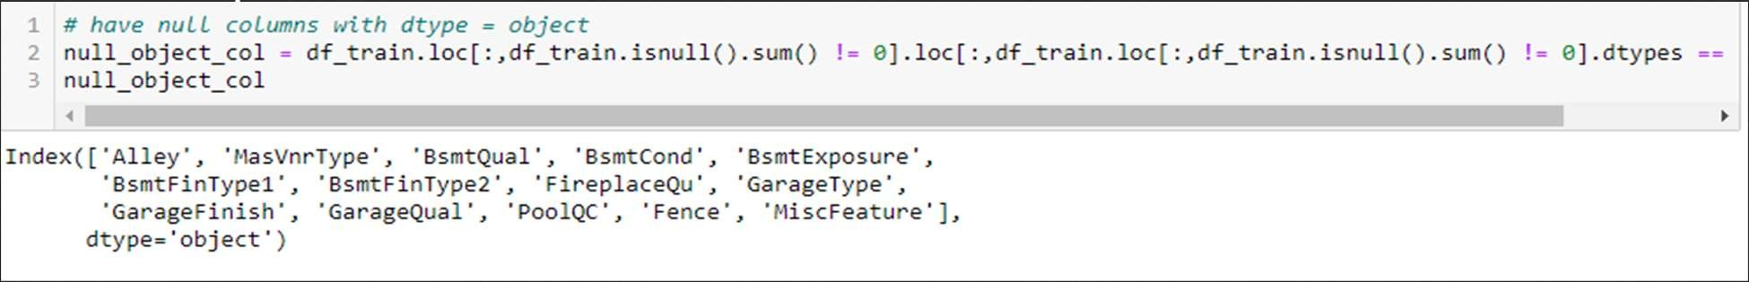
Top columns with null values:
Most “Null” values actually mean “Not Available”
Example: PoolQC - Pool quality – Not Available means “No Pool”
Update all meaningful “Null_object col” to “Not Available”
For numerical columns like LotFrontage, GarageYrBlt, MasVnrArea, mean is used to replace the null values

Slide 5

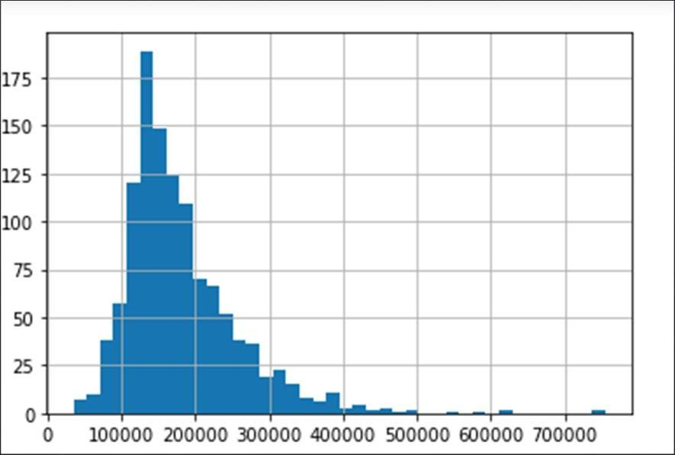
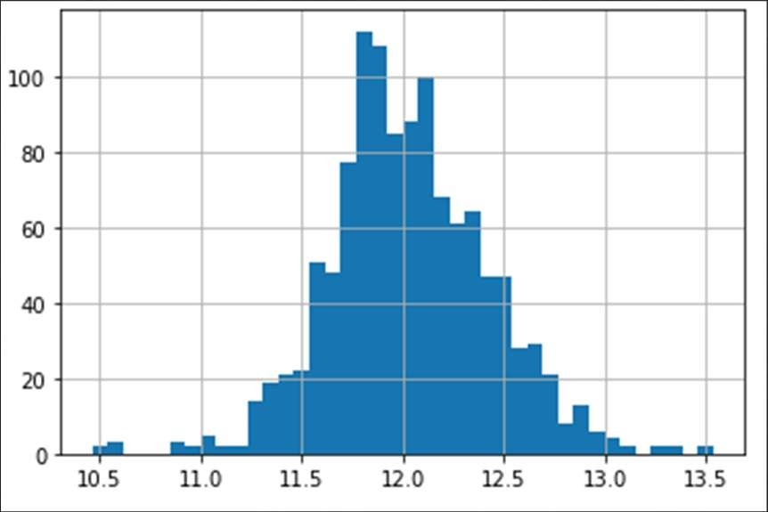
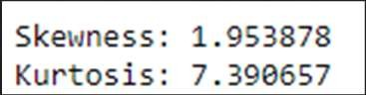
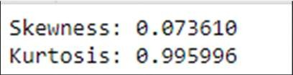
Before removing skewness
After removing skewness
Since the target column is skewed towards right. So applying log transformation

Slide 6
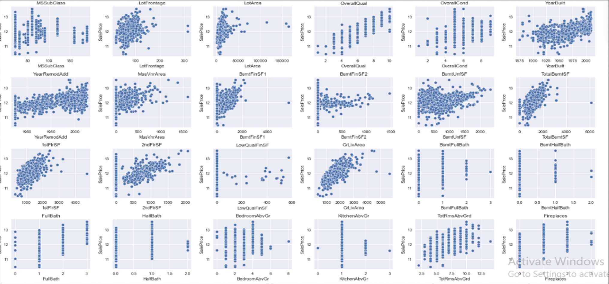

Slide 7
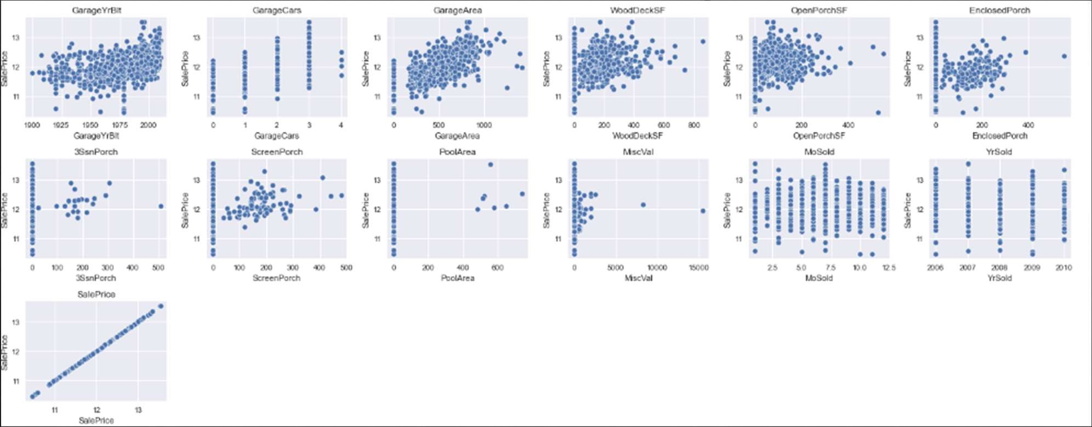
Numerical Features Analysis Cont..
Here in all the numerical columns we can see through scatter plot that many numerical features are skewed on either the left side or right side. Also, there are so many outliers in the features.

Slide 8
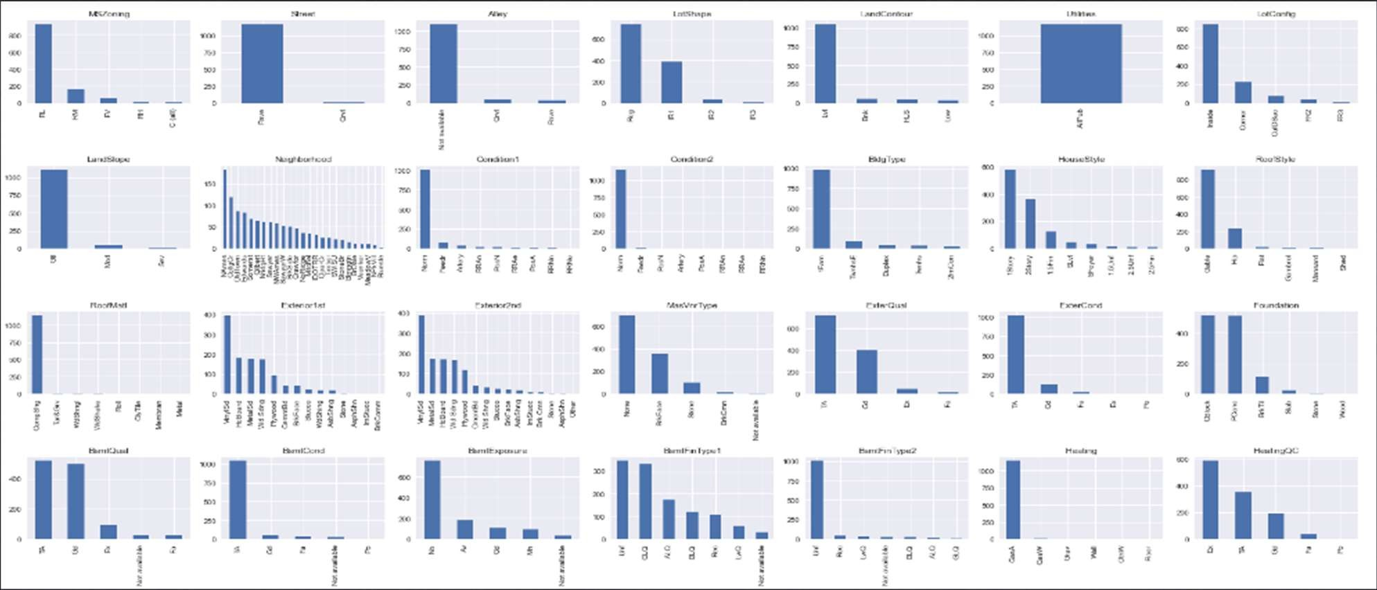

Slide 9
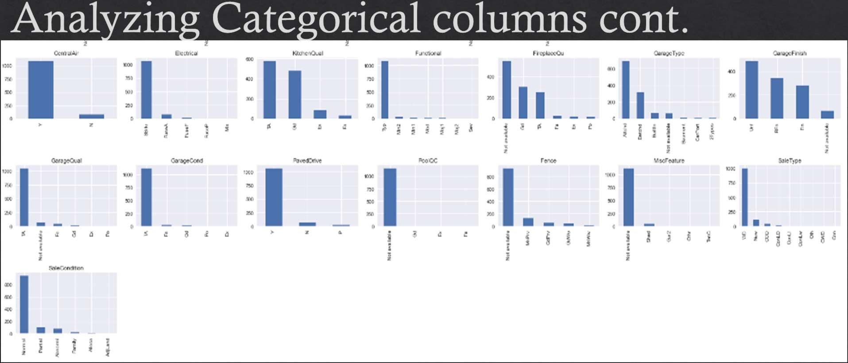
Through bar charts of different categorical columns, we can see unique values and the value counts for categorical features.

Slide 10
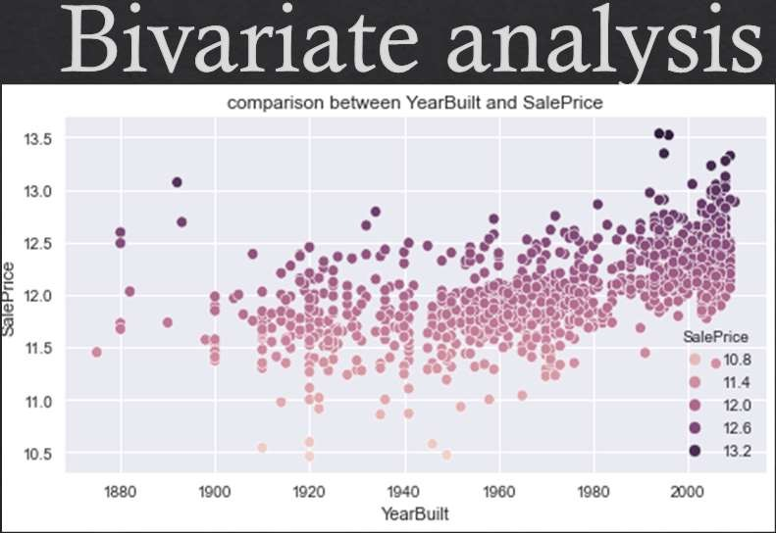

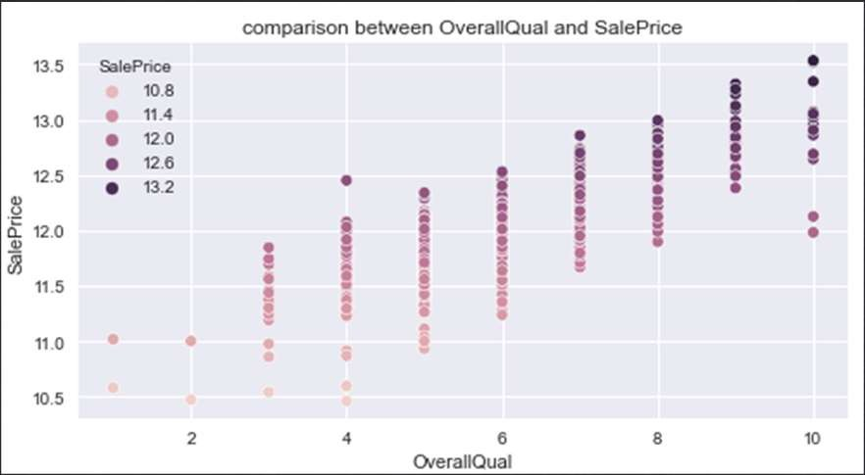
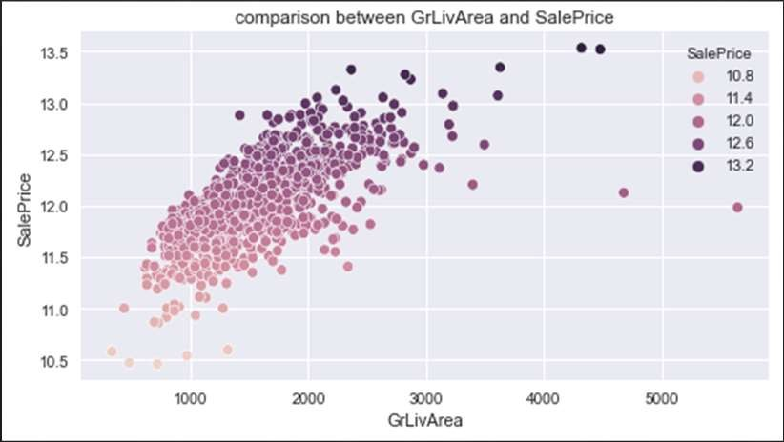
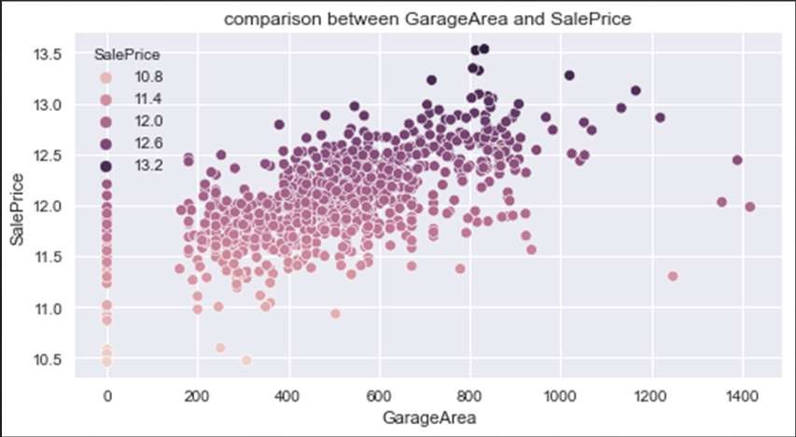
For all the above variables, Sale price increases with their

Slide 11
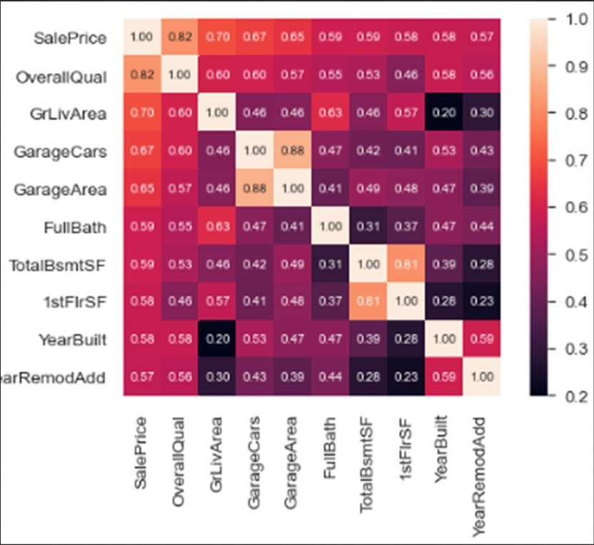
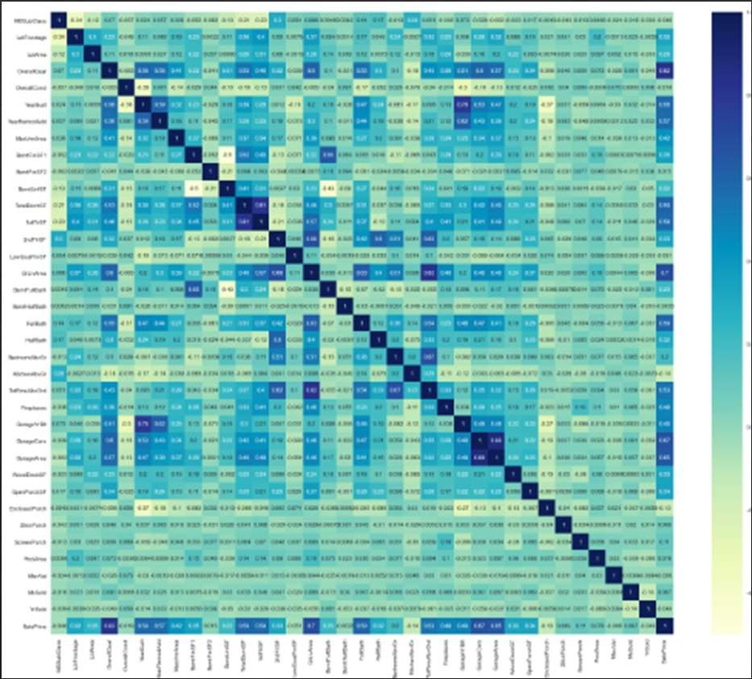
There is multicollinearity among the columns sale price and OverallQual, GarageCars And GarageArea,TotalBsmtSf and 1stFlrSF. But these columns have high correlation with target also

Slide 12

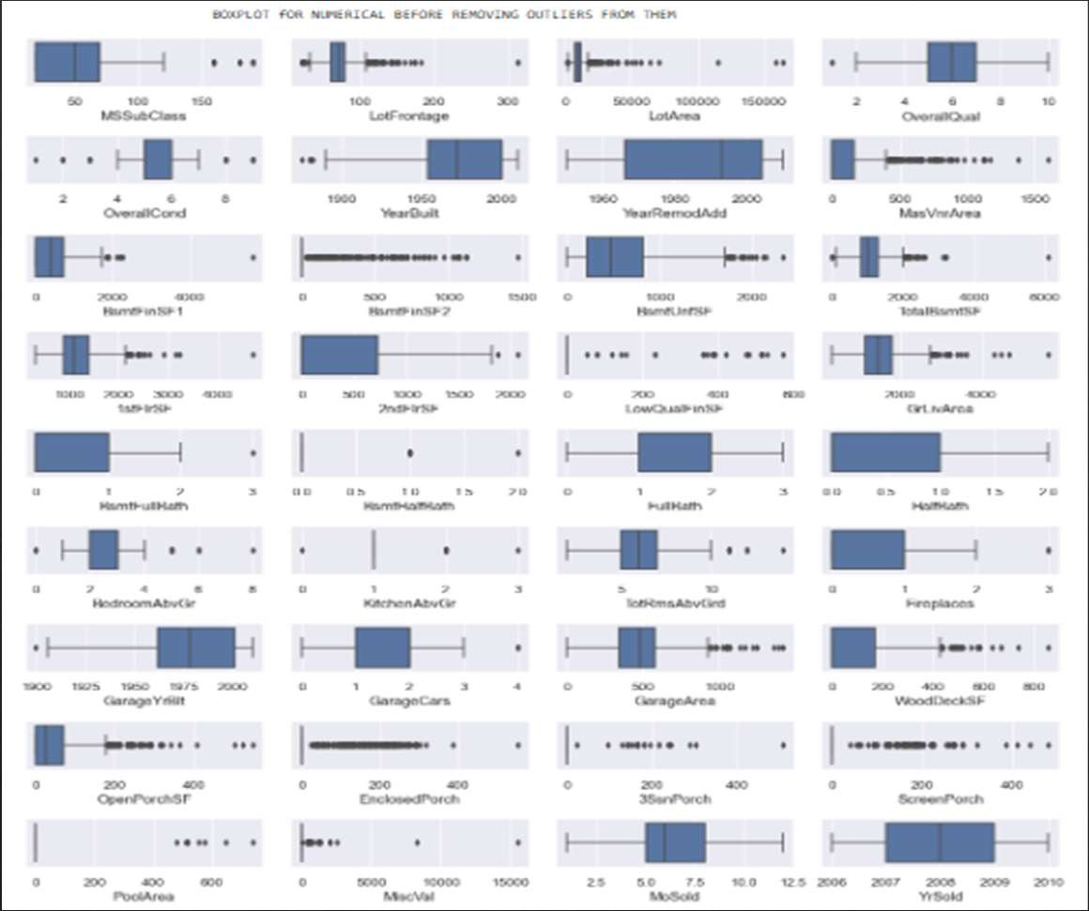
So many outliers are there in all the features. We removed the outliers using the interquartile method.

Slide 13
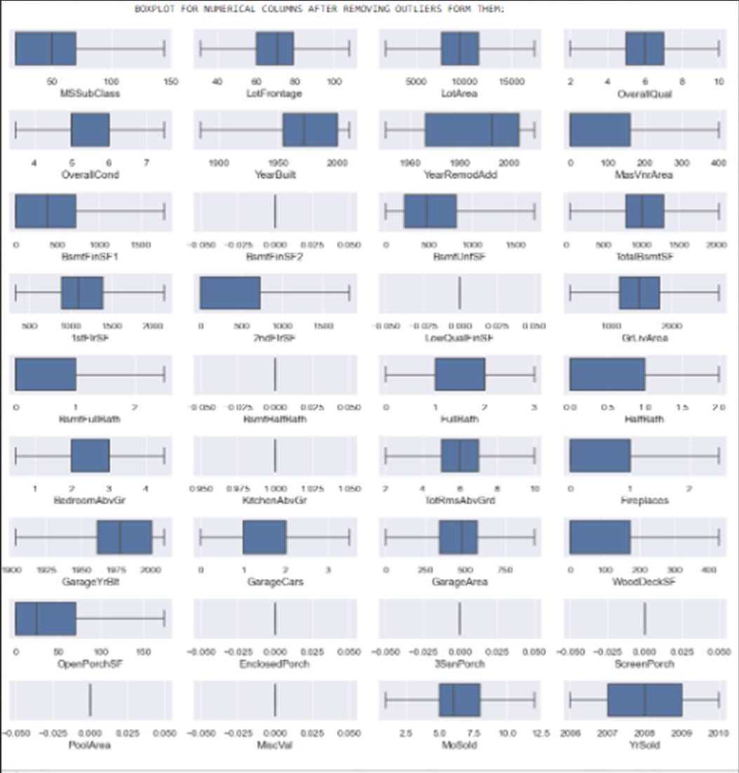
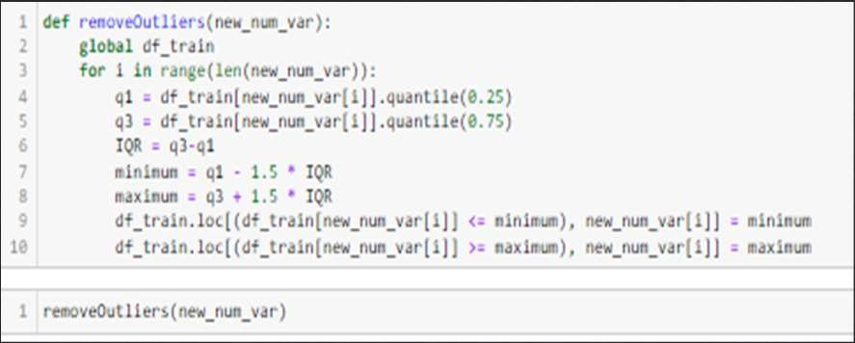
Removing Outliers
We can see in the box plots, the outliers are removed

Slide 14
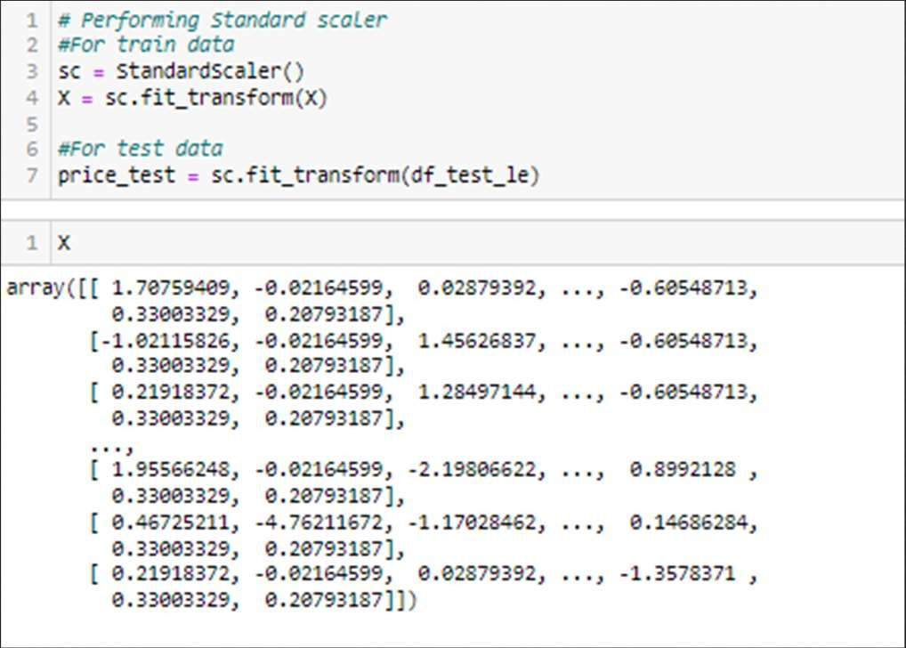
Converted all the categorical columns to numerical columns using
Label encoder
By using a standard scaler, I have scaled the data in one range.

Slide 15


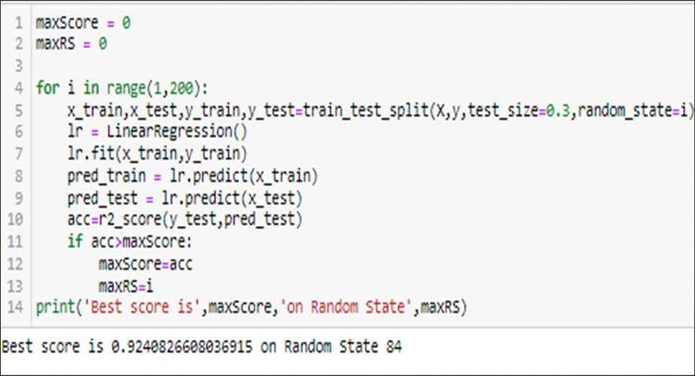
Applying on 5 different algorithms
LinearRegression(),
Lasso()
Ridge()
DecisionTreeRegressor()
KNeighborsRegressor()]

Slide 16
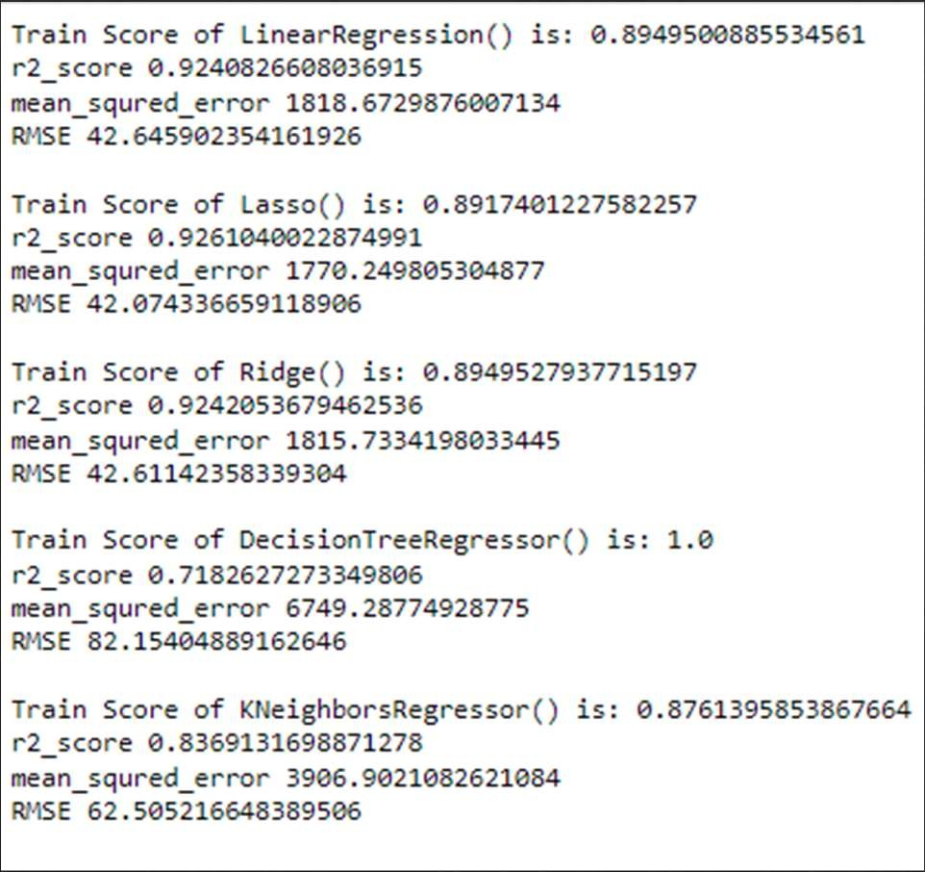
The Decision tree regressor model is overfitting. Other models are working well. But lasso regression is having less train and test score difference with least mean square error and least RMSE.

Slide 17
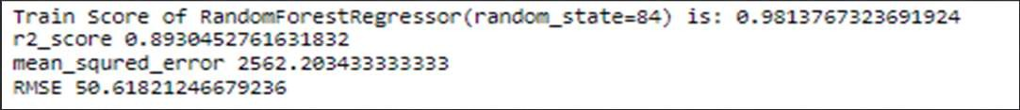
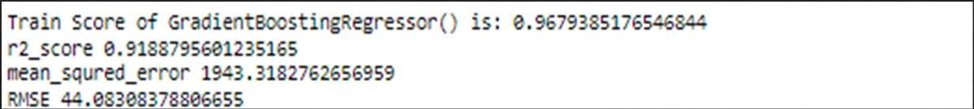
Random Forest Regressor:
AdaBoostRegressor:
GradientBoostingRegressor:
RandomForestRegressor and GradientBoostRegressor is overfitting. I have found that AdaBoostRegressor() is working well on the dataset with the least train score and test score difference and have given less RMSE score . So i am selecting AdaBoostRegressor for final Model.

Slide 18
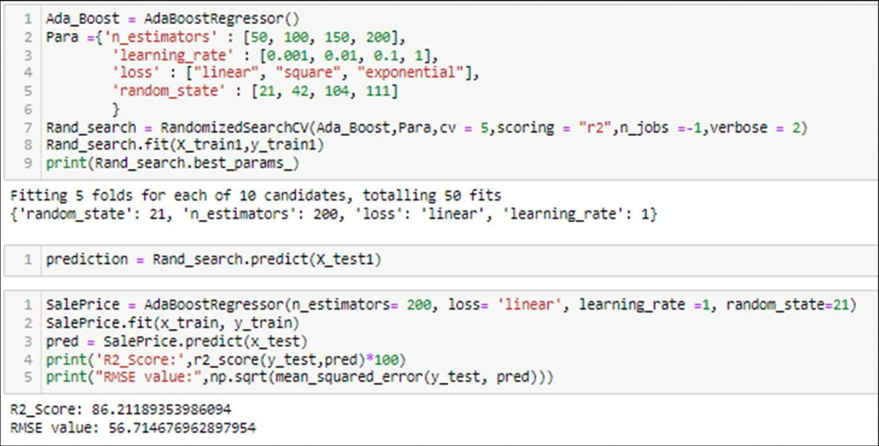

Slide 19
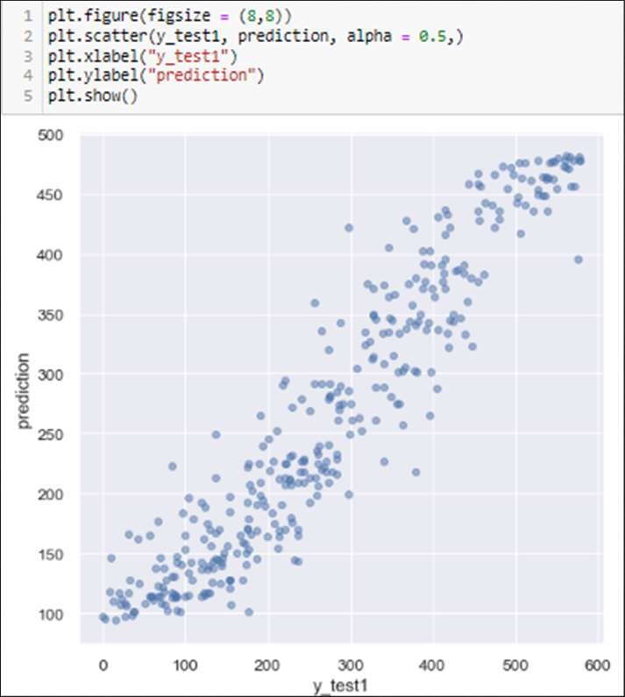
Plotting y_test vs predictions.

Slide 20


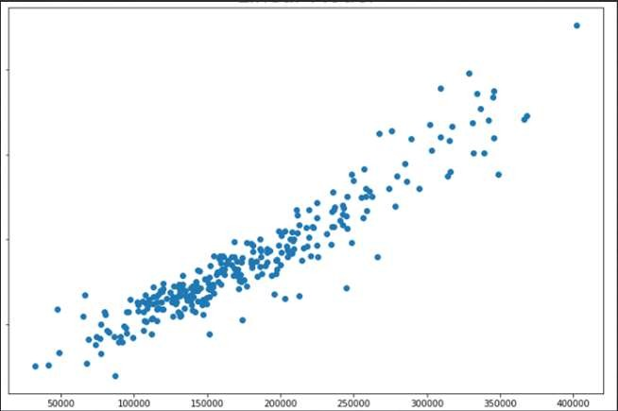
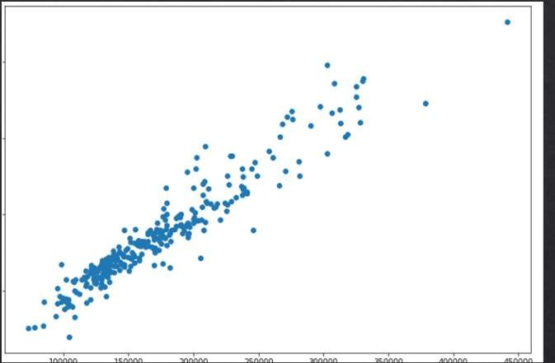
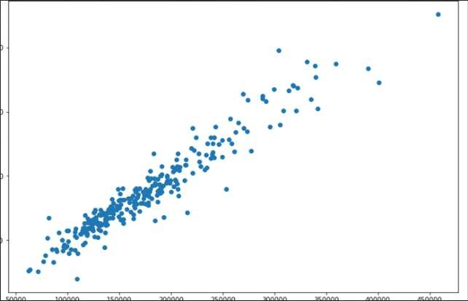
Actual Value
Predicted Value

Slide 21

We have done a complete EDA process, getting data insights, feature engineering, and data visualization as well so after all these steps one can go for the prediction using machine learning model-making steps.
We have training and test file separately available with us. we have both numerical and categorical data types features in both datasets and the dependent variable of train data i.e. the price is the numerical data type. So, I applied the regression method for prediction.
Once data has been cleaned for both test and train datasets, Label encoding is applied to them to convert them into Numerical ones. I trained the model on five different algorithms but for most of the models, train and test data was having a high variance, and the model was overfitting.
Only Ada Boost regressor worked well out of all the models, as there was less difference between train score and test score and RMSE was also low hence I used it as the final model and have done further processing.
After applying hyperparameter tuning I got an accuracy(r2_score) of 86% from the Ada Boost Regressor model which is a good score. Then I applied that score to the test dataset to get the target variable which is price.

Slide 22



